Slide 1


ITM 540
Data Networks
The Network Layer
Layer 3
Dynamic Routing – EGP/BGP
Professor: Carol Davids
Email: davids@iit.edu
Carol Davids © 2008
© 2008 Illinois Institute of Technology
Notes:
Last routing protocol

Slide 2
Reading Assignment
Forouzan :
Topic: Unicast Routing:
Carol Davids © 2008

Slide 3
Border Gateway Protocol
Routers at the edge of an Autonomous System need to run an exterior or border gateway protocol.
BGP is a particular type of border gateway protocol.
Before we look at the specifics of the BGP, we will look at the method, “Path Vector Routing” that BGP uses to create its routing table and to route datagrams across a backbone network.
Carol Davids © 2008

Slide 4
Path Vector Routing
We have studied distance vector and link state methods of routing already.
But BGP uses neither of these.
Instead it uses a method called Path Vector Routing.
Carol Davids © 2008

Slide 5
Path Vector Routing vs. Distance Vector
Distance vector would not be a good method, because:
  The metric (hop count) is too limiting.
  The method is unstable, since only the hop count and not the actual route is given. This can lead to loops and a failure to converge.
Carol Davids © 2008

Slide 6
Path Vector Routing vs. Link State
Link State routing would not be a good method, because:
  The link-state database that every router on the internet would need to keep is too large.
  The time to calculate the routes is too long.
  Flooding creates a high volume of network traffic
Carol Davids © 2008

Slide 7
Path Vector Method
The information in a path vector routing table is:
  Destination Network
  Next Router to get to that network
  Path to reach that network
Carol Davids © 2008

Slide 8
Path Vector Method
Assume that one node on each Autonomous System (AS) acts on behalf of the entire AS
We designate it the Speaker Node
The Speaker Node in one AS, creates a routing table and then shares that routing table with the Speaker Nodes in neighboring AS’s
Carol Davids © 2008

Slide 9
Path Vector Routing Table
Speaker Nodes advertise paths not metrics
Carol Davids © 2008

Slide 10
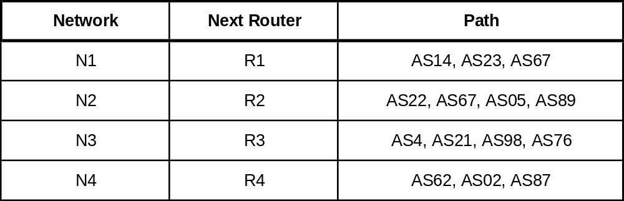
Sample Path Vector Routing Table
You can reach N1 by hopping to R1 and then traversing AS14, AS23 and AS67 in that order
Carol Davids © 2008
Notes:
Different from ospf rip, decomber 4

Slide 11
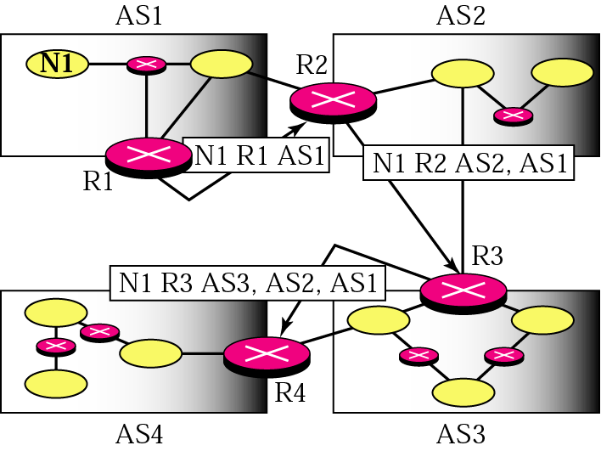
Path Vector Messages
Path vector messages advertise the reach-ability of networks. (from figure 21.21 pg 559, ed 3).
Each router adds itself to the advertisement saying, You can get to N1 by hopping to R1 in AS1. You can get to N1 by hopping to R2, traversing AS2 and then AS1, etc.
Carol Davids © 2008

Slide 12
Explanation of diagram
Here are four autonomous systems, each with a border gateway router.
R1 sends a path vector message N1 R1 AS1, which advertises that you can reach network N1 via R1 which will allow you to enter AS1.
R2 receives that message, updates its own routing table, and then adds itself to the path vector for N1 as follows…
Carol Davids © 2008

Slide 13
Explanation of diagram
R2 sends this path vector: N1 R2 AS2, AS1
This means that you can reach the network N1, if you hop to R2 on AS2, which will lead you to AS1 where N1 is located.
When R3 receives this message, it updates its routing table and adds itself to the path vector as follows…
Carol Davids © 2008

Slide 14
Explanation of diagram
R3 sends the path vector message N1 R3 AS3, AS2, AS1.
This means that you can reach N1 by hopping to R3, traversing AS3, AS2 and finally AS1 where N1 is located.
Carol Davids © 2008

Slide 15
Initialization
In Figure 22.30, we see four AS’s.
Each speaker node only knows about the destination networks within the AS
Each speaker node sends its routing table to its neighbors
Carol Davids © 2008

Slide 16
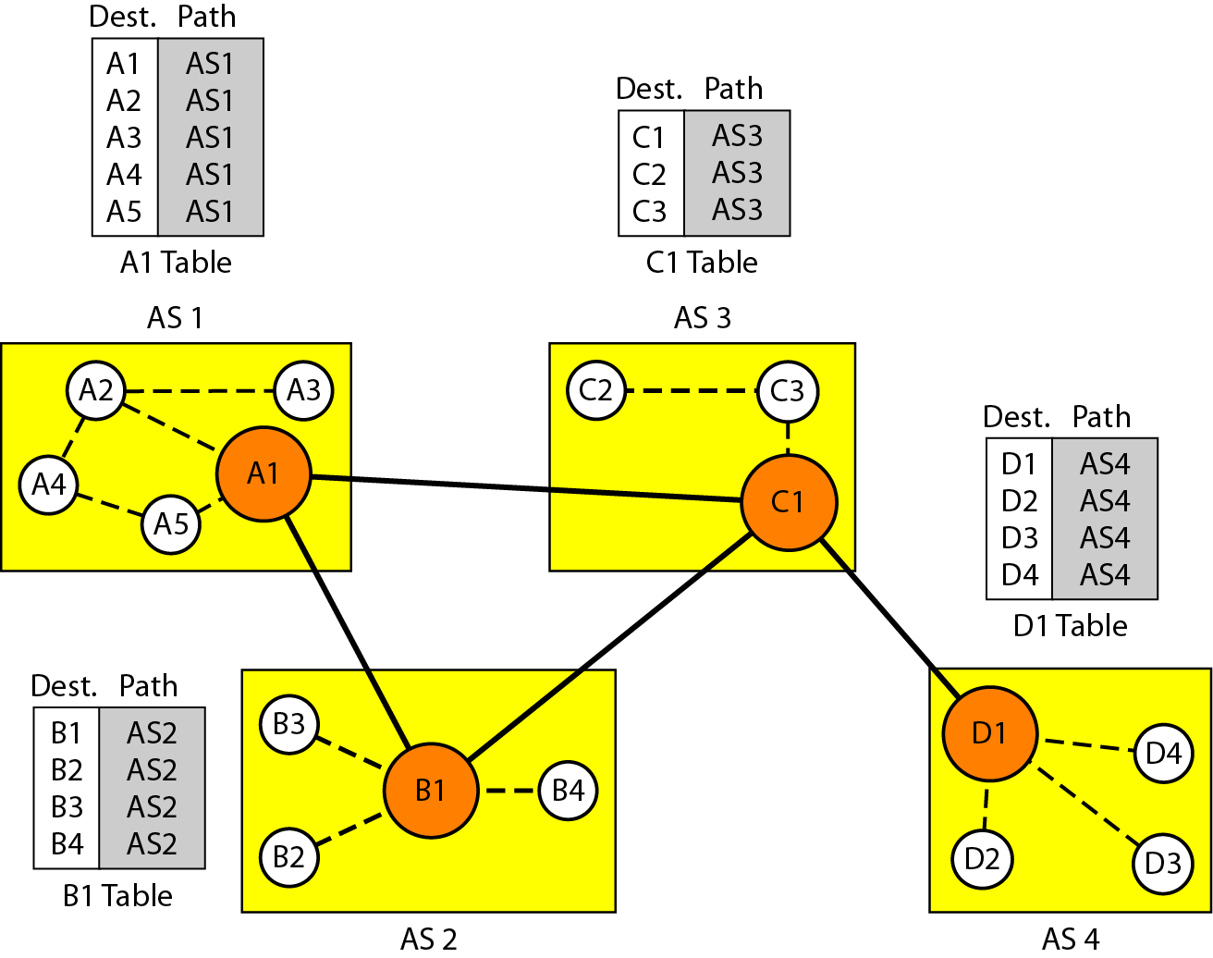
Initialization
In Figure 22.30 of edition 4
Carol Davids © 2008

Slide 17
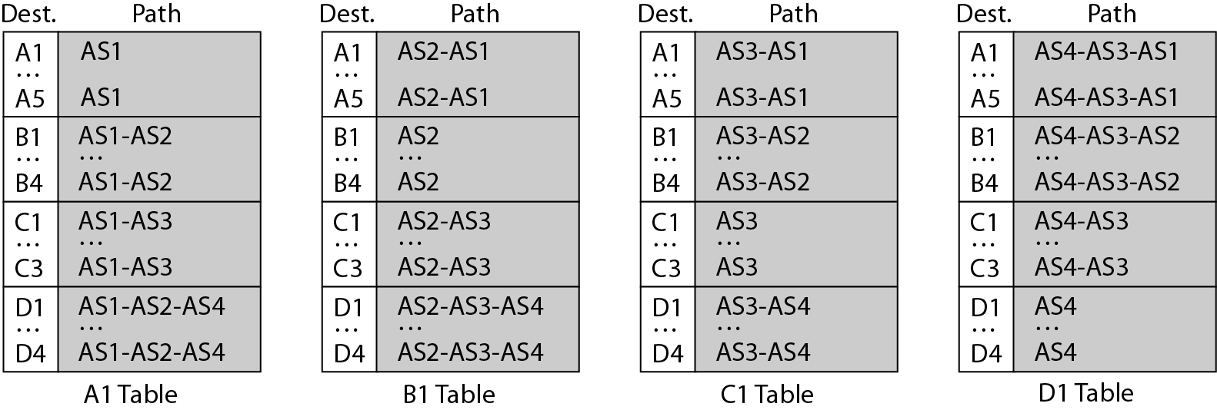
Stabilized tables
In illustration 22.31, the neighbors have exchanged their routing tables.
Here, if D1 in AS4 receives an IP datagram destined for A2 in AS1, the D1 routing table tells D1 to use the path: AS4-AS3-AS1.
Carol Davids © 2008

Slide 18
Advantages of path vector routing
Prevents loops
When the router receives a path vector message it checks to see if its AS is in the path list to a destination network
If it is, the message is not used to update the routing table
Carol Davids © 2008

Slide 19
Advantages of path vector routing
Enables policy routing
The policy of a particular AS may include things like “do not traverse any AS that does not implement security precautions”.
If a router receives a path vector message that includes an AS on the ‘banned’ list, the router can choose not to include the information in the message.
Carol Davids © 2008

Slide 20
Advantages of path vector routing
Enables policy routing (continued)
This means that you don’t always take the shortest path, but you do take only paths that your policy allows.
Carol Davids © 2008

Slide 21
Advantages of path vector routing
Path vector provides attributes
The information contained in the path is actually more complex than simply the AS identification
It describes attributes (characteristics) of the path
The ORIGIN attribute, for example tells what method was used to derive the route. Its value could be RIP or OSPF, for example.
Carol Davids © 2008

Slide 22
Advantages of path vector routing
Path vector provides attributes (continued)
AS_PATH attribute defines the list of autonomous systems that must be traversed to reach the destination network.
NEXT_HOP attribute identifies the next router to which the packet should be sent
The attributes can be compared to the policy and the best route can then be chosen and placed in the routing table
Carol Davids © 2008

Slide 23
The Border Gateway Protocol (BGP)
BGP is specified in RFC 1267, 1268 and 1467, published in 1991, 1991, and 1993 respectively.
BGP is an Exterior Gateway Protocol that enables routers on different Autonomous Systems to communicate with each other.
Carol Davids © 2008

Slide 24
BGP Protocol
BGP protocol messages are used to create sessions between routers
There are two types of sessions possible – Internal BGP and External BGP
Internal BGP sessions are established between routers in the same AS
External BGP sessions are established between speaker nodes on different AS’s.
Carol Davids © 2008

Slide 25
BGP Messages
BGP messages include the full path to a destination AS.
This full path is used to construct a graph showing how the AS’es are connected.
Carol Davids © 2008

Slide 26
BGP transport protocol
BGP uses TCP for its transport protocol.
  TCP is the connection-oriented transport of the IP model.
  The TCP port used by BGP is 179.
Carol Davids © 2008

Slide 27
BGP transport protocol
Two systems running BGP establish a TCP connection and then exchange the entire BGP routing table.
After this initial exchange, incremental updates are sent as the routing table changes.
Carol Davids © 2008

Slide 28
Routing IP datagrams using BGP
An IP datagram in an Autonomous System is categorized as carrying either local traffic or transit traffic.
Carol Davids © 2008

Slide 29
Routing IP datagrams using BGP
Local traffic either originates on the AS or terminates on the AS.
That is, either its source of its destination IP Address is a host on the AS.
Transit traffic neither originates nor terminates on the AS.
This means that transit traffic is “just passing through”.
Carol Davids © 2008

Slide 30
Categories of AS
Stub AS
  Has only a single connection to one other AS.
  Carries only local traffic
Carol Davids © 2008

Slide 31
Categories of AS
Multihomed AS
  Has connections to more than one other AS.
  Refuses to carry transit traffic.
Transit AS
  Has connections to more than one other AS.
  Accepts to carry both local and transit traffic.
Carol Davids © 2008

Slide 32
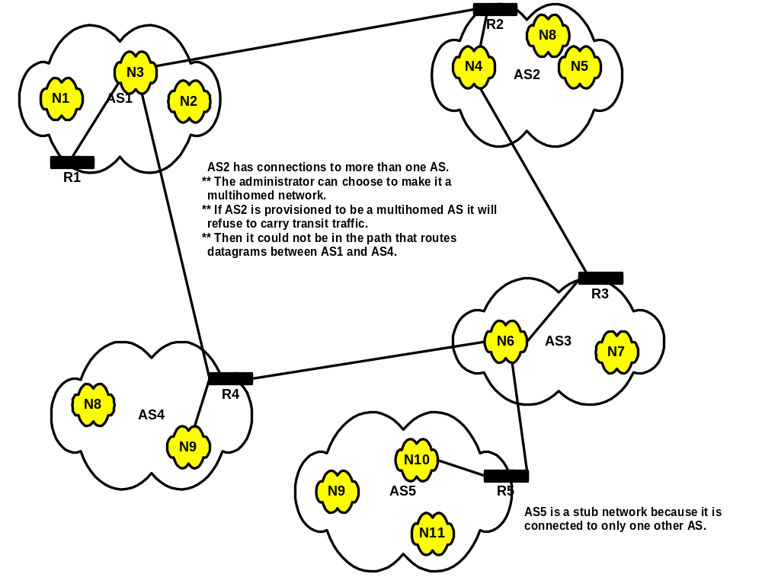
Carol Davids © 2008

Slide 33
BGP required by Transit AS
A Transit AS must run a Border Gateway Protocol.
Carol Davids © 2008

Slide 34
BGP detection of link or host failure
BGP sends a regular keep-alive message at the application layer.
Normally the keep-alive is sent every 30 seconds.
If the far end does not respond to the keep-alive messages, the sender will eventually remove the AS from its routing table.
Carol Davids © 2008

Slide 35
Border Gateway Protocol
BGP is now in its fourth version.
It enables routing between autonomous systems.
The method it uses is called Path Vector Routing.
Carol Davids © 2008

Slide 36
Neighbors
Two autonomous boundary routers connected to the same network are neighbors.
Remember that Autonomous Systems are collections of networks under a common administrative authority.
The illustration on the next page shows Autonomous System Boundary Routers and their relations to networks and neighbors.
Carol Davids © 2008

Slide 37
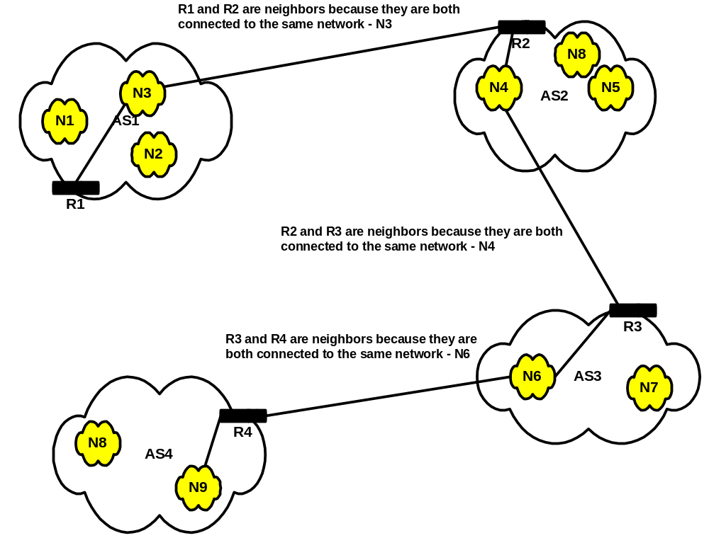
Carol Davids © 2008

Slide 38
Router operation using Path Vector method
When a router receives a Path Vector message it:
Verifies that the path being advertised in in accordance with its own policy
Updates its routing table if appropriate
Modifies the message and forwards it to its neighbors
Carol Davids © 2008

Slide 39
Loop Avoidance
A router using BGP prevents loops by checking to see if its own AS is in the path list to the destination.
If it is, then the router ignores the BGP message.
Carol Davids © 2008

Slide 40
Path is a list of Attributes
The path is a list of attributes.
Each attribute describes some aspect of the advertised path.
There are two kinds of attributes - Well-known and Optional.
  Well-known attributes are recognized by all routers running BGP.
  Optional attributes need not be recognized by all BGP routers.
Carol Davids © 2008

Slide 41
Examples of well-known Attributes
NEXT_HOP is the well-known attribute that identifies the next-hop router
Carol Davids © 2008

Slide 42
Examples of well-known Attributes
AS_PATH is the ordered list of AS’es that need to be traversed to reach the destination network
Carol Davids © 2008

Slide 43
Examples of well-known Attributes
ORIGIN defines the source routing protocol that provided the routing information contained in this message
It could be RIP or OSPF for example.
Carol Davids © 2008

Slide 44
BGP Message Types
There are 4 types of BGP message:
  Open
  Update
  Keep-alive
  Notification.
Carol Davids © 2008

Slide 45
Open
Open message is sent to create a neighborhood relationship with another router.
The response to an Open message is a Keep-alive message
Carol Davids © 2008

Slide 46
Update
Update message is used to withdraw previously-advertised paths and to advertise new paths.
A single update message can be used to withdraw several paths.
A single update message can only advertise one new path.
Carol Davids © 2008

Slide 47
Keep-alive
Keep-alive messages are exchanged by neighbors to assure each other that they are up and running.
  A timer is set after the receipt of a keep-alive message from Router N and a new BGP message must be received from Router N before that timer expires .
  Failing this, the receiving router will start some kind of remedial action.
Carol Davids © 2008

Slide 48
Notification
Notification messages are sent to report errors or to close the connection between the two routers.
Carol Davids © 2008

Slide 49
The End
Carol Davids © 2008

